Slide 1
Quicksort

Slide 2
Efficient sorting method
Quicksort is a divide-and-conquer sorting algorithm in which division is dynamically carried out
Different from merge sort-
Merge sort-
divide array at midpoint to 2 subarray,
sort independently,
merge results
Quicksort –
divide the main array to 2 subarray
Sort each subarray
No need to merge

Slide 3
a[l..n] array to sort
Select a pivot element a[m] from the array
There are many different versions of quickSort that pick pivot in different ways.
Always pick first element as pivot.
Always pick last element as pivot
Pick a random element as pivot.
Pick median as pivot.

Slide 4
The three steps of Quicksort are as follows:
Divide: Rearrange the elements and split the array into two subarrays and an element in between such that each element in the left subarray is less than or equal the middle element and each element in the right subarray is greater than the middle element.
Conquer: Recursively sort the two subarrays.
Combine: None.

Slide 5
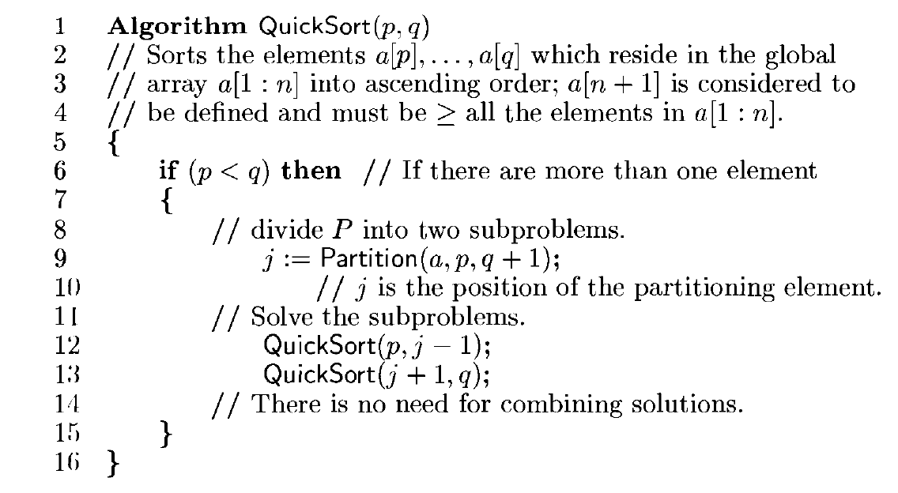

Slide 6
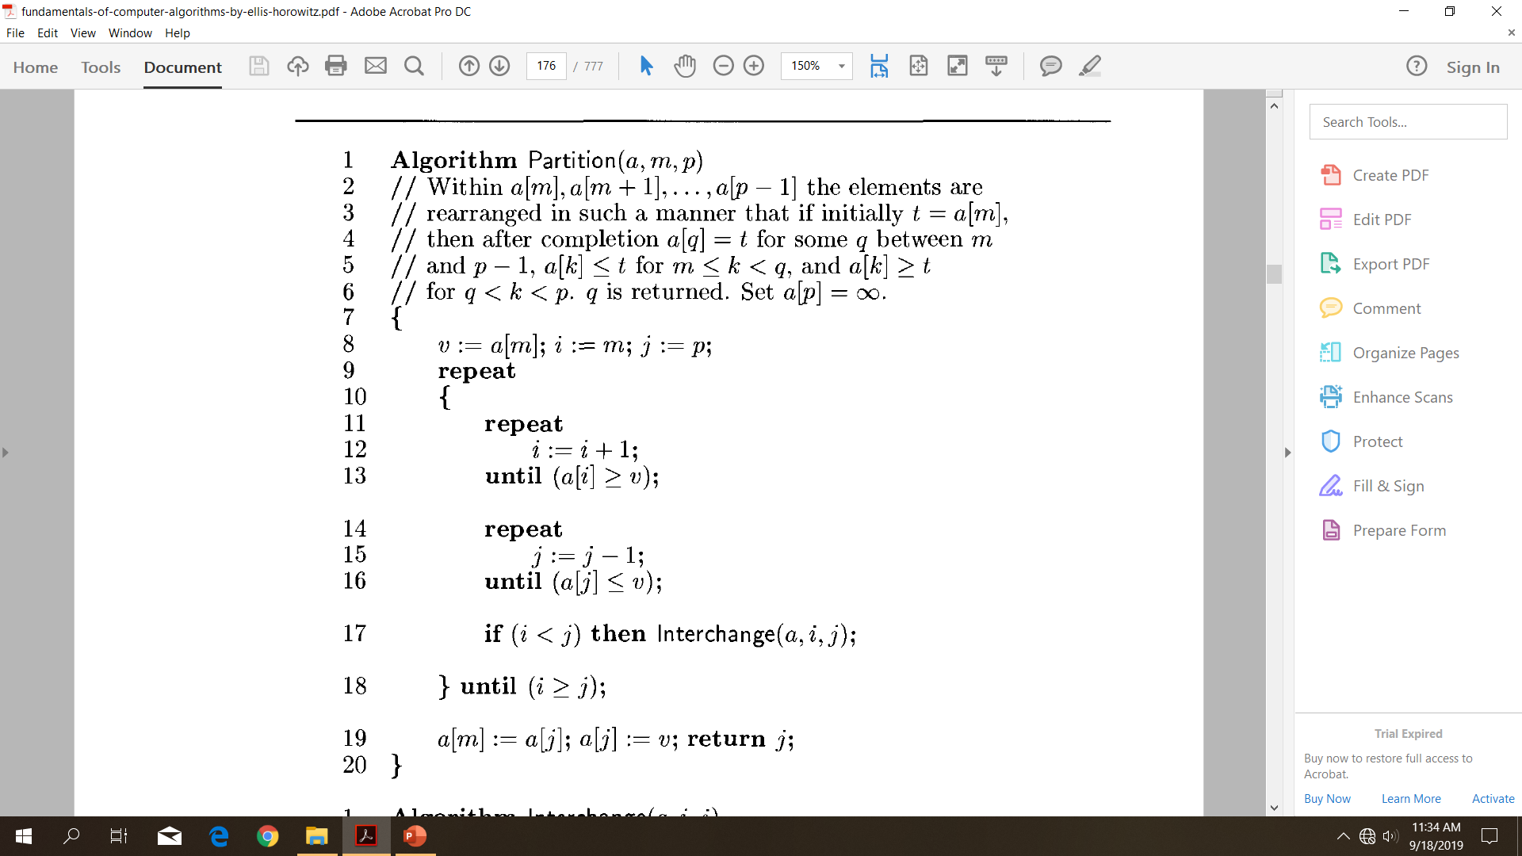

Slide 7
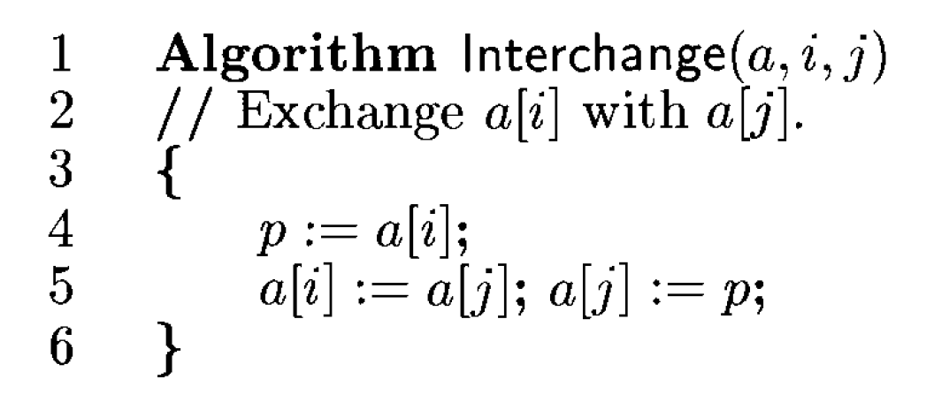

Slide 8
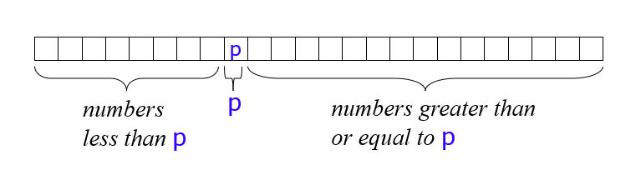
The key process in quickSort is partition().
Target of partitions is, given an array and an element x of array as pivot, put x at its correct position in sorted array and put all smaller elements (smaller than x) before x, and put all greater elements (greater than x) after x.

Slide 9
Example of partitioning
choose pivot: 4 3 6 9 2 4 3 1 2 1 8 9 3 5 6 ∞
search: 4 3 6 9 2 4 3 1 2 1 8 9 3 5 6 ∞
swap: 4 3 3 9 2 4 3 1 2 1 8 9 6 5 6 ∞
search: 4 3 3 9 2 4 3 1 2 1 8 9 6 5 6 ∞
swap: 4 3 3 1 2 4 3 1 2 9 8 9 6 5 6 ∞
search: 4 3 3 1 2 4 3 1 2 9 8 9 6 5 6 ∞
swap: 4 3 3 1 2 2 3 1 4 9 8 9 6 5 6 ∞
search: 4 3 3 1 2 2 3 1 4 9 8 9 6 5 6 ∞ (left > right)
swap with pivot: 1 3 3 1 2 2 3 4 4 9 8 9 6 5 6 ∞

Slide 10
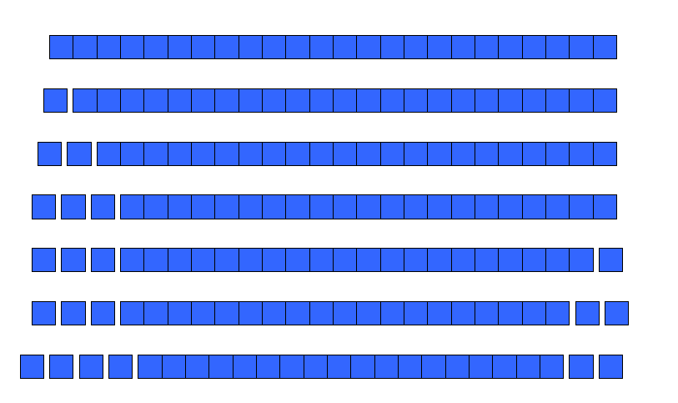
the worst case time complexity of QuickSort is O(n²)

Slide 11
There are many arrangements that could make this happen
Here are two common cases:
When the array is already sorted
When the array is inversely sorted (sorted in the opposite order)

Slide 12
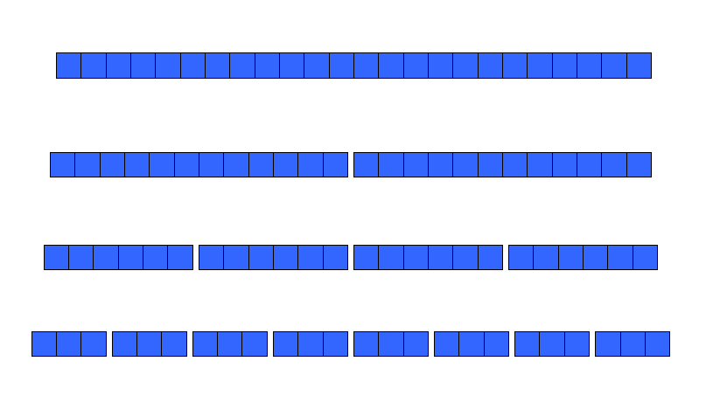
Analysis of quicksort—best case
best case is n Log₂n
We cut the array size in half each time

